Slide 1
Couchbase Server

Slide 2
Agenda
Where does Couchbase fit in?
Key Concepts & use cases
Develop with Agility
Operate at any scale

Slide 3
Big Data = Operational + Analytic (NoSQL + Hadoop)
Online
Web/Mobile/IoT apps
Millions of customers/consumers
Offline, batch-oriented
Analytics apps
Hundreds of business analysts
Notes:
KEY POINTS: BIG DATA IS NOT ONE THING – IT’S A COMBINATION OF OPERATIONAL (NOSQL) AND ANALYTICAL DATABASES. YOU NEED BOTH. COUCHBASE PROVIDES THE OPERATIONAL SOLUTION.
Big data has two major pieces: Operational and Analytical
Operational is about:
Real time
Online, interactive
Customer/consumer facing
Processing data at high velocity
Analytical is about:
Offline analytics
Often batch oriented
Takes time processing
Directly touches relatively few users (business analysts)
These two pieces together form “Big Data”
There’s some overlap
NoSQL can deliver some analytics
Hadoop can deliver some operational
But in general each technology designed for separate purposes
Couchbase fits on the operational side, Hadoop on the analytics side

Slide 4
Key Capabilities
Combines the flexibility of JSON, the power of SQL and the scale of NoSQL
Develop with Agility
Multiple data models
N1QL - SQL-Like query language
Multiple indexes
Languages, ODBC / JDBC drivers and frameworks you already know
N1QL
Operate at Any Scale
Push-button scalability
Consistent high-performance
Always on 24x7 with HA - DR
Easy Administration with Web UI, Rest API and CLI
Notes:
Idiomatic implementations = SDKs written to feel natural to the languages we support
API Compatibility = ODBC/JDBC and memcached

Slide 5
Couchbase provides a complete Data Management solution
General purpose capabilities support a broad range of apps and use cases
N1QL
Highly available cache
Key-value store
Document database
Embedded database
Sync management

Slide 6

Enterprises use Couchbase to enable key objectives
Profile Management
360 Degree Customer View
Internet of Things
Mobile Applications
Personalization
Content Management
Catalog
Real Time Big Data
Digital Communication
Fraud Detection
Notes:
KEY POINT: ENTERPRISES ARE USING COUCHBASE ACROSS A RANGE OF MISSION CRITICAL USE CASES.
As the slide shows, Couchbase supports a wide range of use cases, from Profile Management to Fraud Detection.
Each use case has its own set of requirements – some need very high performance, some need very high availability, some need flexibility of the data model.
The ability to meet all of these requirements is what has driven adoption of Couchbase.

Slide 7
Develop with Agility

Slide 8
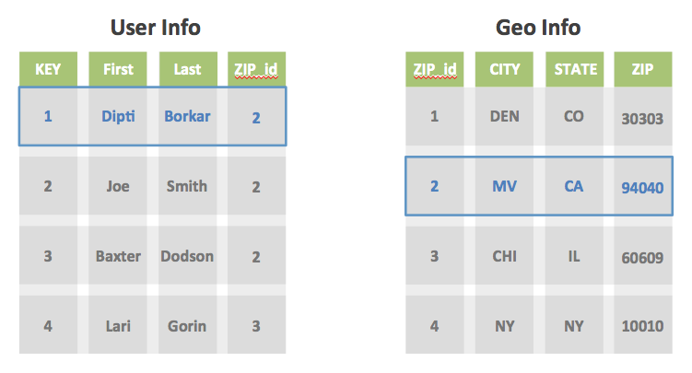
What does a JSON document look like?
{ “ID”: 1, “FIRST”: “Dipti”, “LAST”: “Borkar”, “ZIP”: “94040”, “CITY”: “MV”,
“STATE”: “CA” }
=
+
JSON
All data in a single document
Notes:
Example.
Normalized schema
2 tables
Fk connects the two.
To get information about a specific error, you will perform and join across the two tables

Slide 9


Storing and retrieving documents
Documents
Clients
User/application data
Read from / Written to
Data Buckets
Servers
Which live on
Server Nodes
Based on hash partitioning
That form a
Couchbase Cluster
Dynamically scalable

Slide 10
Accessing Data in Couchbase
Multiple Access Paths
Functional
Allow for querying, execution of other directives such as defining indexes and checking on index state.
API
abucket.NewN1QLQuery( “SELECT * FROM default LIMIT 5” )
.Consistency(gocouchbase.RequestPlus);
Functional
Hold on to cluster information such as topology.
API
Reference Cluster Management
openBucket()
info()
disconnect()
Functional
Give the application developer a concurrent API for basic (k-v) or document management
API
get()
insert()
upsert()
remove()
Functional
Manage connections to the bucket within the cluster for different services.
Provide a core layer where IO can be managed and optimized.
Provide a way to manage buckets.
API
insertDesignDocument()
flush()
listDesignDocuments()
Functional
Allow for view querying, building of queries and reasonable error handling from the cluster.
API
abucket.NewViewQuery().Limit().Stale()
CRUD
View Query
N1QL Query
Data Service
Query & Index
Services
Cluster

Slide 11
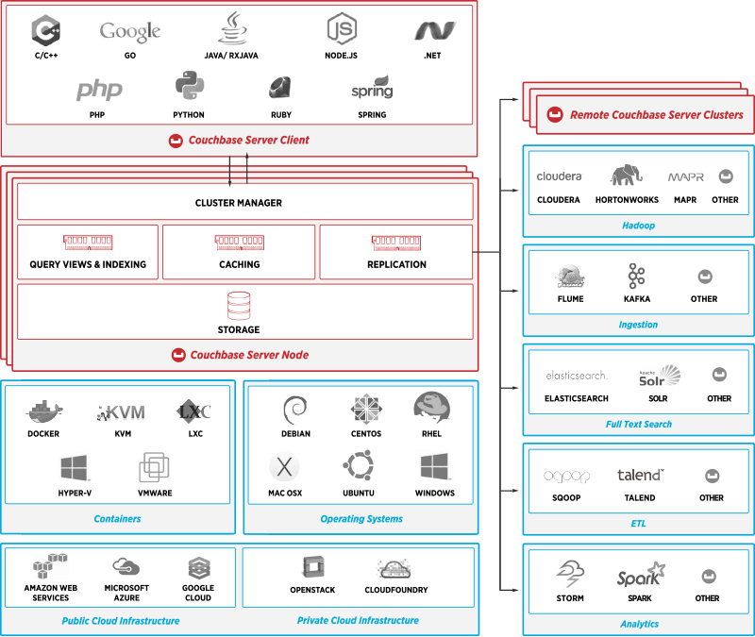
Couchbase SDKs and Connectors

Slide 12

Why SQL for NoSQL
JSON document model provides
Rich Structure (no assembly)
Structure Evolution (flexible schema, seamless change)
SQL provides
Query across relationships
Query in general
Why SQL for JSON?
To address all these data concerns
N1QL is SQL for JSON

Slide 13
N1QL is SQL for JSON
Next generation, NoSQL query language
SQL-like : SELECT * FROM WHERE/LIKE/GROUP/etc.,
JOINS
Powerful Extesions (nest, unnest) for JSON to support nested and hierarchical data structures.
Multiple backend access paths – Views and global secondary indexes
ODBC/JDBC drivers available
Notes:
Incorporate detail slide about nest and unnest

Slide 14
Models for Representing Data
Data Concern | Relational Model | JSON Document Model (NoSQL)
Rich Structure | Multiple flat tables Constant assembly and disassembly | Documents No assembly required!
Relationships | Represented Queried (SQL) | Represented Queried? Not so far…
Value Evolution | Data can be updated | Data can be updated
Structure Evolution | Uniform and rigid Change is disruptive and manual | Flexible Change is seamless and data-driven

Slide 15
SELECT
Standard SELECT pipeline
SELECT, FROM, WHERE, GROUP BY, ORDER BY, LIMIT, OFFSET
Queries across relationships
JOINs
Subqueries
NEST — a JOIN that embeds child objects within their parent
UNNEST — a JOIN that surfaces nested objects as top-level data
Aggregation
Set operators
UNION, INTERSECT, EXCEPT

Slide 16
Query Execution: Join
Document key: “customer285”
Document key: “purchase1492”
"customer": {
"ccInfo": {
"cardExpiry": "2015-11-11",
"cardNumber": "1212-1221-1121-1234",
"cardType": "americanexpress"
},
"customerId": "customer285",
"dateAdded": "2014-04-06T15:52:16Z",
"dateLastActive": "2014-05-06T15:52:16Z",
"emailAddress": "jason_skiles@kertzmann.name",
"firstName": "Mckayla",
"lastName": "Brown",
…
"postalCode": "92341",
"state": "VT",
"type": "customer"
}
“purchases”:{
"customerId": "customer285",
"lineItems": [
{"count": 3,
"product": "product55”},
{"count": 4,
"product": "product169”},],
"purchaseId": "purchase7049",
"type": "purchase”
}
Document key: “purchase583”
"purchases": {
"customerId": "customer285",
"lineItems": [
{ "count": 5,
"product”: "prod551" },
{ "count": 3,
"product": "product549" }, ],
"purchaseId": "purchase3648",
"purchasedAt": "2013-11-07T15:52:38Z",
"type": "purchase"
}
SELECT c.emailAddress, count(p)
FROM purchases p
JOIN customers c
ON KEYS (p.customerId)
GROUP BY c.emailAddress

Slide 17
Queries are only as fast as the index
CREATE / DROP INDEX
Two types of indexes
View indexes
GSI indexes (global secondary indexes—new)
Can index any data expression
Nested / complex expressions
Computed expressions
EXPLAIN

Slide 18
N1QL Architecture
Single node installation, services defined dynamically
Query service access Index and Data to formulate response
All queries and direct access is topology aware and dynamically scalable
Notes:
We now run a different key through through the has and we now come up with differnet vbucket, vbucket 4 and that points to server 3

Slide 19
Operate at Any Scale

Slide 20

Couchbase Architecture – Single Node
Data Service – builds and maintains Distributed secondary indexes (MapReduce Views)
Indexing Engine – builds and maintains Global Secondary Indexes
Query Engine – plans, coordinates, and executes queries against either Global or Distributed indexes
Cluster Manager – configuration, heartbeat, statistics, RESTful Management interface
Data
Service
Index
Service
Query
Service
Management REST API Web UI
Managed Cache
View Engine
Indexing
Engine
Query Engine
Node / Cluster Orchestration
Storage
Managed Cache
Managed Cache
Storage
Erlang / OTP
Node Manager
Cluster Manager
Couchbase Server Node
20

Slide 21

Data Service: Write Operation
Single-node type means easier administration and scaling
Writes are async by default
Application gets acknowledgement when successfully in RAM and can trade-off waiting for replication or persistence per-write
Replication to 1, 2 or 3 other nodes
Replication is RAM-based so extremely fast
Off-node replication is primary level of HA
Disk written to as fast as possible – no waiting
APPLICATION SERVER
DOC 1
MANAGED CACHE
DOC 1
DOC 1
REPLICATION/
XDCR/
CONNECTORS/
VIEWS/
INDEXING
DISK
DISK
QUEUE

Slide 22
Data Service: Read Operation
APPLICATION SERVER
Single-node type means easier administration and scaling
Reads out of cache are extremely fast
No other process/system to communicate with
Data connection is a TCP-binary protocol
GET
DOC 1
MANAGED CACHE
DOC 1
DOC 1
REPLICATION/
XDCR/
CONNECTORS/
VIEWS/
INDEXING
DISK
DISK
QUEUE
DOC 1

Slide 23
Data Service: Cache Miss
Single-node type means easier administration and scaling
Layer consolidation means 1 single interface for App to talk to and get its data back as fast as possible
Separation of cache and disk allows for fastest access out of RAM while pulling data from disk in parallel
APPLICATION SERVER
GET
DOC 1
MANAGED CACHE
DOC 1
DOC 2
DOC 3
DOC 4
DOC 5
REPLICATION/
XDCR/
CONNECTORS/
VIEWS/
INDEXING
DISK
DISK
QUEUE
DOC 1
DOC 1
DOC 2
DOC 3
DOC 4
DOC 5

Slide 24
Couchbase Views
Local Index
Distributed indexing and scatter gather querying
Incremental Map-Reduce
Distributed simple real-time analytics
Only considers changes due to updated data
Notes:
Indexing and querying
distributed
create indexes on the fields in JSON documents
Called Views in Couchabse Server
Views are queried to find the objects you are interested in, e.g. range queries to find all players that have black sheep on their farm
(if asked: No ad-hoc query language. Index are described via simple Javascript.)
Incremental Map Reduce
“Normal” map reduce is batch based: i.e. it has to run across all data everytime. So you don’t get updated results often, especially over large data sets. Incremental Map reduce is only considering data that has changed and then calculates the updated result.
This happens fast, in near real-time.
Distributed across all nodes, so able to cope with large data amounts
Does single map and reduce step, so great for simple analytics like leaderboards, counts sums, across data having specific attributes/charcteristics.
Full Text Search
Integration with separate Elastic search cluster, using XDCR technology
Robust, so will efficiently cope with node failures rebalances or interrupted connections to keep the full text index in sync
Elastic search is a very fast JSON document based full text indexing open source solution, based on Apache Lucene (the same as used by SOLR that more people will know)
Elastic search is also clustered and scales easily and provides very flexible and powerful full text search capabilities

Slide 25
Index Service

Slide 26
Couchbase Global Indexing Service
Global Secondary Index Service
New to 4.0
Indexes partitioned independently from data
Each index receives only its own mutations
Managed Caching layer
ForestDB storage engine
B+ Trie optimized for very large data volumes
Optimized for SSD’s
Index#1
Index#2
Index#3
Index#4
Supervisor
Index maintenance &
Scan coordinator
Indexing Service

Slide 27
Couchbase Indexing Service
2) Each index receives only its mutations
1) Projector/Router in Data Service controls what data gets sent where
3) Query engine knows which index to use for which query
Index#1
Index#2
Index#3
Index#4
...
Query Engine
Projector & Router
Bucket#2
Bucket#1
Supervisor
Index maintenance &
Scan coordinator
Data Service
Query Service
Indexing Service

Slide 28
Query Service

Slide 29
Query Execution Flow
SELECT c_id, c_first,
c_last, c_max
FROM CUSTOMER WHERE c_id = 49165;
{
"c_first": "Joe",
"c_id": 49165,
"c_last": "Montana",
"c_max" : 50000
}
Clients
1. Submit the query over REST API
8. Query result
Query Service
2. Parse, Analyze, create Plan
7. Evaluate: Documents to results
3. Scan Request; index filters
5. Fetch Request,
doc keys
Data Service
Index Service
4. Get qualified doc keys
6. Fetch the documents

Slide 30
Couchbase Query Engine
j
Request
Response
Client
Pre-Aggregate
Parse
Plan
Scan
Fetch
Join
Filter
Aggregate
Sort
Offset
Limit
Project
Parallel Processing — Query latency scales with cores
In-Memory
Pluggable architecture — datastore, indexer, client, …
Index Service
Data Service

Slide 31
Couchbase Clustering Architecture

Slide 32

Auto sharding – Bucket and vBuckets
Data buckets
vB
vB
vB
vB
1 ….. 1024
1 ….. 1024
Active Virtual buckets
Replica Virtual buckets

Slide 33
Cluster Map

Slide 34
Data Services – Sharding and Replication
Application has single logical connection to cluster (client object)
Multiple nodes added or removed at once
One-click operation
Incremental movement of active and replica vbuckets and data
Client library updated via cluster map
Fully online operation, no downtime or loss of performance
READ/WRITE/UPDATE
ACTIVE
ACTIVE
ACTIVE
ACTIVE
ACTIVE
SHARD
5
SHARD
2
SHARD
9
SHARD
4
SHARD
7
SHARD
8
SHARD
1
SHARD
3
SHARD
6
SHARD
SHARD
SHARD
SHARD
SHARD
SHARD
SHARD
SHARD
SHARD
REPLICA
REPLICA
REPLICA
REPLICA
REPLICA
SHARD
4
SHARD
1
SHARD
8
SHARD
6
SHARD
3
SHARD
2
SHARD
7
SHARD
9
SHARD
5
SHARD
SHARD
SHARD
SHARD
SHARD
SHARD
SHARD
SHARD
SHARD
Couchbase Server 1
Couchbase Server 2
Couchbase Server 3
Couchbase Server 4
Couchbase Server 5

Slide 35
What is Multi-Dimensional Scaling?
MDS is the architecture that enables independent scaling of data, query and indexing workloads while being managed as one cluster
node1
node8
Index Service
Query Service
Data Service
Couchbase Cluster

Slide 36
Modern Architecture
Independent Scalability for Best Computational Capacity per Service
Heavier indexing (index more fields) : scale up index service nodes
More RAM for query processing: scale up query service nodes
Query Service
Index Service
node1
node8
node9
Data Service
Couchbase Cluster

Slide 37
Cross Data Center Replication

Slide 38
Market leading memory-to-memory replication
New York
San Francisco
Notes:
KEY POINT: COUCHBASE’S MEMORY-TO-MEMORY DATA REPLICATION IS MARKETING DEFINING AND UNIQUE TO COUCHBASE – IT’S ONE OF THE KEY REASONS ENTERPRISES CHOOSE COUCHBASE OVER RELATIONAL DATABASES AND OTHER NOSQL PRODUCTS.
The built-in replication in Couchbase is extremely fast and highly scalable.
It’s memory to memory – which means it’s not limited by the slower speed of reading data from a disk, so it’s very, very fast.
And it’s extremely scalable – you can very high throughput with large numbers of writes going from one cluster to another. You can have different topology on both sides. Obviously you need to have the capacity appropriately sized so they can handle the load.
This memory-to-memory replication is market defining and unique to Couchbase. No other solution like this, built into the database, exists in the market today.
This is one of the key reasons enterprises choose Couchbase over other NoSQL products like MongoDB and Cassandra, and over relational databases.

Slide 39
In summary
The best of both worlds
Develop with Agility
Multiple data models
N1QL - SQL-Like query language
Multiple indexes
Languages, ODBC / JDBC drivers and frameworks you already know
N1QL
Operate at Any Scale
Push-button scalability
Consistent high-performance
Always on 24x7 with HA - DR
Easy Administration with Web UI, Rest API and CLI
Notes:
Idiomatic implementations = SDKs written to feel natural to the languages we support
API Compatibility = ODBC/JDBC and memcached

Slide 40
Thank you!

